Slide 1
Concurrency Control
Introduction
Problems in Concurrency Control
Concurrency Techniques/Protocols

Slide 2
Introduction
It is the method of managing concurrent operations on the database without getting any obstruction with one another.
Concurrency control in DBMS is an important concept that is related to the transactions and data consistency of the database management systems. Concurrency control refers to the process of managing independent operations of the database that are simultaneous and considered as a transaction in DBMS. Concurrency Control works on the principle of maintaining the transactions state that can be a complete transaction or an incomplete transaction. In the case of the complete transaction, all the associated database operations need to be completed with specified rules and sequences, whereas an incomplete transaction occurs in case all the database operations are not completed due to some technical, power failure, or network connectivity issue.

Slide 3
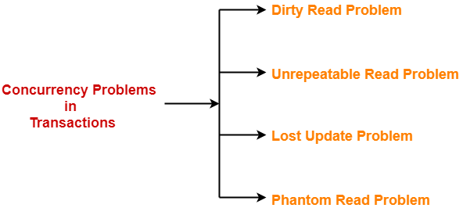
Problems in Concurrency Control
When multiple transactions execute concurrently in an uncontrolled or unrestricted manner, then it might lead to several problems.
Such problems are called as concurrency problems.

Slide 4
1. Dirty Read Problem-
Reading the data written by an uncommitted transaction is called as dirty read.
This read is called as dirty read because-
There is always a chance that the uncommitted transaction might roll back later.
Thus, uncommitted transaction might make other transactions read a value that does not even exist.
This leads to inconsistency of the database.
NOTE-
Dirty read does not lead to inconsistency always.
It becomes problematic only when the uncommitted transaction fails and roll backs later due to some reason.

Slide 5
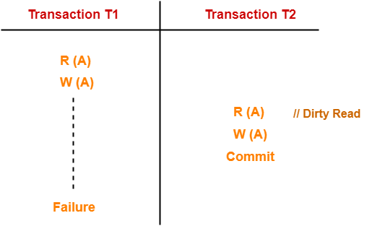
Example- Dirty Read Problem-
Here,
T1 reads the value of A.
T1 updates the value of A in the buffer.
T2 reads the value of A from the buffer.
T2 writes the updated the value of A.
T2 commits.
T1 fails in later stages and rolls back.
In this example,
T2 reads the dirty value of A written by the uncommitted transaction T1.
T1 fails in later stages and roll backs.
Thus, the value that T2 read now stands to be incorrect.
Therefore, database becomes inconsistent.

Slide 6
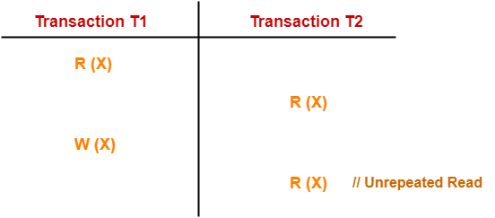
2. Unrepeatable Read Problem-
This problem occurs when a transaction gets to read unrepeated i.e. different values of the same variable in its different read operations even when it has not updated its value.
Example-
Here,
T1 reads the value of X (= 10 say).
T2 reads the value of X (= 10).
T1 updates the value of X (from 10 to 15 say) in the buffer.
T2 again reads the value of X (but = 15).
In this example,
T2 gets to read a different value of X in its second reading.
T2 wonders how the value of X got changed because according to it, it is running in isolation.

Slide 7
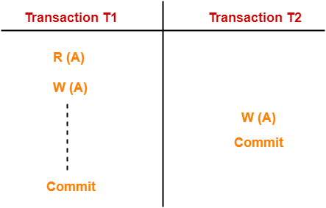
3. Lost Update Problem-
This problem occurs when multiple transactions execute concurrently and updates from one or more transactions get lost.
Here,
T1 reads the value of A (= 10 say).
T1 updates the value to A (= 15 say) in the buffer.
T2 does blind write A = 25 (write without read) in the buffer.
T2 commits.
When T1 commits, it writes A = 25 in the database.
In this example,
T1 writes the over written value of X in the database.
Thus, update from T1 gets lost.
Example-
NOTE-
This problem occurs whenever there is a write-write conflict.
In write-write conflict, there are two writes one by each transaction on the same data item without any read in the middle.

Slide 8
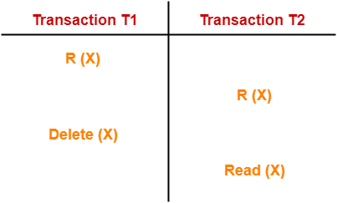
4. Phantom Read Problem-
This problem occurs when a transaction reads some variable from the buffer and when it reads the same variable later, it finds that the variable does not exist.
Example-
Here,
T1 reads X.
T2 reads X.
T1 deletes X.
T2 tries reading X but does not find it.
In this example,
T2 finds that there does not exist any variable X when it tries reading X again.
T2 wonders who deleted the variable X because according to it, it is running in isolation.

Slide 9
Concurrency Techniques/Protocols
Concurrency Control is the working concept that is required for controlling and managing the concurrent execution of database operations and thus avoiding the inconsistencies in the database. Thus, for maintaining the concurrency of the database, we have the concurrency control protocols.

Slide 10
Concurrency Control Protocols
The concurrency control protocols ensure the atomicity, consistency, isolation, durability and serializability of the concurrent execution of the database transactions. Therefore, these protocols are categorized as:
Lock Based Concurrency Control Protocol
Time Stamp Concurrency Control Protocol
Validation Based Concurrency Control Protocol

Slide 11
I. Lock Based Concurrency Control Protocol
Lock Based Protocols in DBMS is a mechanism in which a transaction cannot Read or Write the data until it acquires an appropriate lock. Lock based protocols help to eliminate the concurrency problem in DBMS for simultaneous transactions by locking or isolating a particular transaction to a single user.
A lock is a data variable which is associated with a data item. This lock signifies that operations that can be performed on the data item. Locks in DBMS help synchronize access to the database items by concurrent transactions.
All lock requests are made to the concurrency-control manager. Transactions proceed only once the lock request is granted.

Slide 12
There are two kinds of locks used in Lock-based protocols:
Binary Locks: A Binary lock on a data item can either locked or unlocked states.
Shared/exclusive: This type of locking mechanism separates the locks in DBMS based on their uses. If a lock is acquired on a data item to perform a write operation, it is called an exclusive lock.

Slide 13
1. Shared Lock (S):
A shared lock is also called a Read-only lock. With the shared lock, the data item can be shared between transactions. This is because you will never have permission to update data on the data item.
For example, consider a case where two transactions are reading the account balance of a person. The database will let them read by placing a shared lock. However, if another transaction wants to update that account’s balance, shared lock prevent it until the reading process is over.

Slide 14
2. Exclusive Lock (X):
With the Exclusive Lock, a data item can be read as well as written. This is exclusive and can’t be held concurrently on the same data item. X-lock is requested using lock-x instruction. Transactions may unlock the data item after finishing the ‘write’ operation.
For example, when a transaction needs to update the account balance of a person. You can allows this transaction by placing X lock on it. Therefore, when the second transaction wants to read or write, exclusive lock prevent this operation.

Slide 15
There are four types of lock protocols available:
1. Simplistic lock protocol
2. Pre-claiming Lock Protocol
3. Two-phase locking (2PL)
4. Strict Two-phase locking (Strict-2PL)

Slide 16
1. Simplistic lock protocol
It is the simplest way of locking the data while transaction. Simplistic lock-based protocols allow all the transactions to get the lock on the data before insert or delete or update on it. It will unlock the data item after completing the transaction.

Slide 17
2. Pre-claiming Lock Protocol
Pre-claiming Lock Protocols evaluate the transaction to list all the data items on which they need locks.
Before initiating an execution of the transaction, it requests DBMS for all the lock on all those data items.
If all the locks are granted then this protocol allows the transaction to begin. When the transaction is completed then it releases all the lock.
If all the locks are not granted then this protocol allows the transaction to rolls back and waits until all the locks are granted.

Slide 18
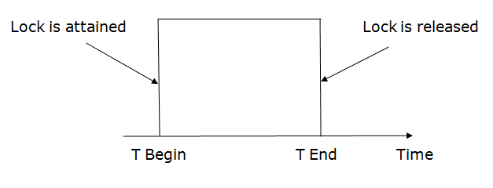

Slide 19
3. Two-phase locking (2PL)
The two-phase locking protocol divides the execution phase of the transaction into three parts.
In the first part, when the execution of the transaction starts, it seeks permission for the lock it requires.
In the second part, the transaction acquires all the locks. The third phase is started as soon as the transaction releases its first lock.
In the third phase, the transaction cannot demand any new locks. It only releases the acquired locks.

Slide 20
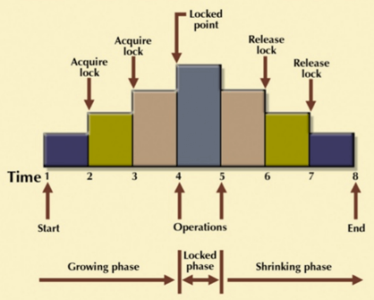
3. Two-phase locking (2PL)
The Two-Phase Locking protocol allows each transaction to make a lock or unlock request in two steps:
Growing Phase: In this phase transaction may obtain locks but may not release any locks.
Shrinking Phase: In this phase, a transaction may release locks but not obtain any new lock.
It is true that the 2PL protocol offers serializability. However, it does not ensure that deadlocks do not happen.
In the above-given diagram, you can see that local and global deadlock detectors are searching for deadlocks and solve them with resuming transactions to their initial states.

Slide 21
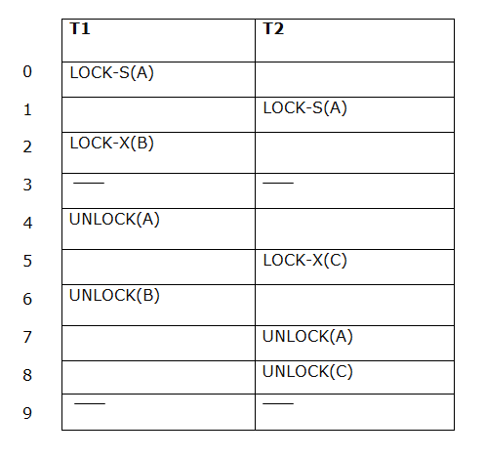
3. Two-phase locking (2PL)
If lock conversion is allowed then the following phase can happen:
Upgrading of lock (from S(a) to X (a)) is allowed in growing phase.
Downgrading of lock (from X(a) to S(a)) must be done in shrinking phase.
The following way shows how unlocking and locking work with 2-PL.
Transaction T1:
Growing phase: from step 0-2
Shrinking phase: from step 4-6
Transaction T2:
Growing phase: from step 1-5
Shrinking phase: from step 7-8

Slide 22
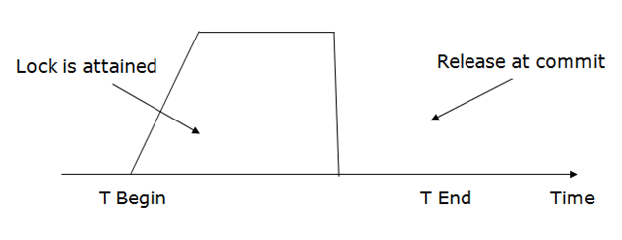
4. Strict Two-phase locking (Strict-2PL)
The first phase of Strict-2PL is similar to 2PL. In the first phase, after acquiring all the locks, the transaction continues to execute normally.
The only difference between 2PL and strict 2PL is that Strict-2PL does not release a lock after using it.
Strict-2PL waits until the whole transaction to commit, and then it releases all the locks at a time.
Strict-2PL protocol does not have shrinking phase of lock release.
It does not have cascading abort as 2PL does.

Slide 23
II. Timestamp Ordering Protocol
The Timestamp Ordering Protocol is used to order the transactions based on their Timestamps. The order of transaction is nothing but the ascending order of the transaction creation.
The priority of the older transaction is higher that's why it executes first. To determine the timestamp of the transaction, this protocol uses system time or logical counter.
The lock-based protocol is used to manage the order between conflicting pairs among transactions at the execution time. But Timestamp based protocols start working as soon as a transaction is created.
Let's assume there are two transactions T1 and T2. Suppose the transaction T1 has entered the system at 007 times and transaction T2 has entered the system at 009 times. T1 has the higher priority, so it executes first as it is entered the system first.
The timestamp ordering protocol also maintains the timestamp of last 'read' and 'write' operation on a data.

Slide 24
Basic Timestamp ordering protocol works as follows:
1. Check the following condition whenever a transaction Ti issues a Read (X) operation:
If W_TS(X) >TS(Ti) then the operation is rejected.
If W_TS(X) <= TS(Ti) then the operation is executed.
Timestamps of all the data items are updated.
2. Check the following condition whenever a transaction Ti issues a Write(X) operation:
If TS(Ti) < R_TS(X) then the operation is rejected.
If TS(Ti) < W_TS(X) then the operation is rejected and Ti is rolled back otherwise the operation is executed.
Where,
28.8554istory of Java
TS(TI) denotes the timestamp of the transaction Ti.
R_TS(X) denotes the Read time-stamp of data-item X.
W_TS(X) denotes the Write time-stamp of data-item X.

Slide 25
Validation Based Protocol
Validation phase is also known as optimistic concurrency control technique. In the validation based protocol, the transaction is executed in the following three phases:
Read phase: In this phase, the transaction T is read and executed. It is used to read the value of various data items and stores them in temporary local variables. It can perform all the write operations on temporary variables without an update to the actual database.
Validation phase: In this phase, the temporary variable value will be validated against the actual data to see if it violates the serializability.
Write phase: If the validation of the transaction is validated, then the temporary results are written to the database or system otherwise the transaction is rolled back.

Slide 26
Here each phase has the following different timestamps:
Start(Ti): It contains the time when Ti started its execution.
Validation (T_{i}): It contains the time when Ti finishes its read phase and starts its validation phase.
Finish(Ti): It contains the time when Ti finishes its write phase.
This protocol is used to determine the time stamp for the transaction for serialization using the time stamp of the validation phase, as it is the actual phase which determines if the transaction will commit or rollback.
Hence TS(T) = validation(T).
The serializability is determined during the validation process. It can't be decided in advance.
While executing the transaction, it ensures a greater degree of concurrency and also less number of conflicts.
Thus it contains transactions which have less number of rollbacks.

Slide 27


